Slide 1
Spice
get creative in the kitchen

Slide 2
Problem/Solution Overview
Problem: For college students cooking is a need, but is perceived as unexciting and a waste of time.
Solution: Spice will elevate both the experience of cooking as well as the meal through simple tips, tasks, and community interactions tuned to the user’s skill level and time constraints. So let’s get creative in the kitchen!

Slide 3
Three Tasks
Simple: Input a usual meal and output a simple way to elevate it to make meals exciting again
Medium: Post/chat/share with others within the app to foster a cooking community
Complex: Cook with others virtually so that cooking is a social experience

Slide 4
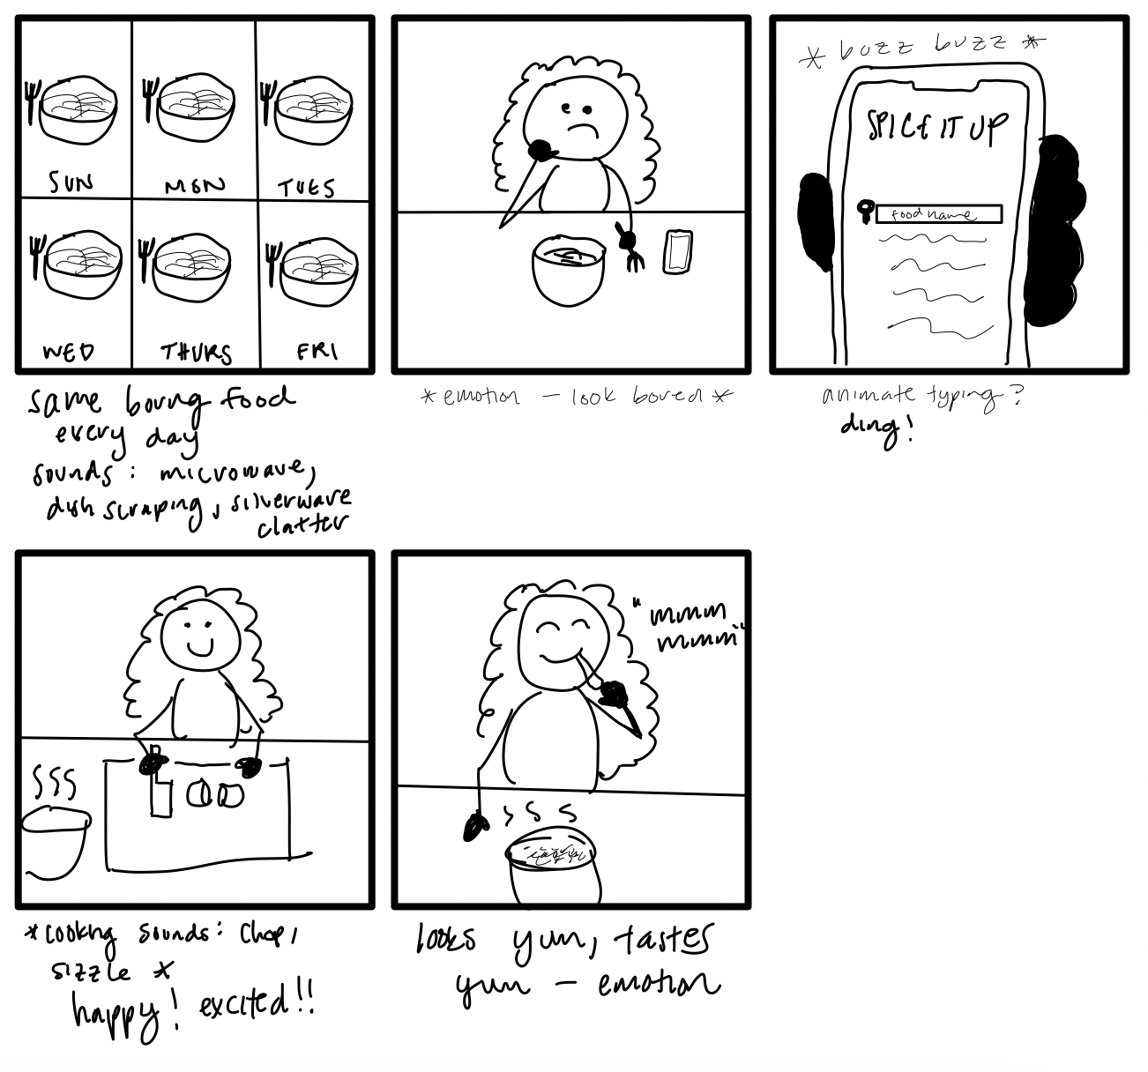
Storyboards: Scene 1
Notes:
Scenes: Shot 7 scenes with the actress looking bored at her meal
The ding represents her coming up with an idea

Slide 5
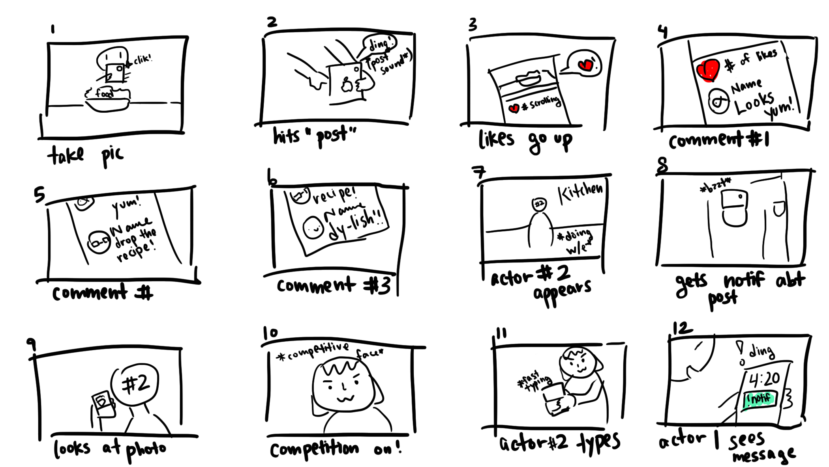
Storyboards: Scene 2
Notes:
Takes picture of food and gets feedback from friends!
Then a challenge text...

Slide 6
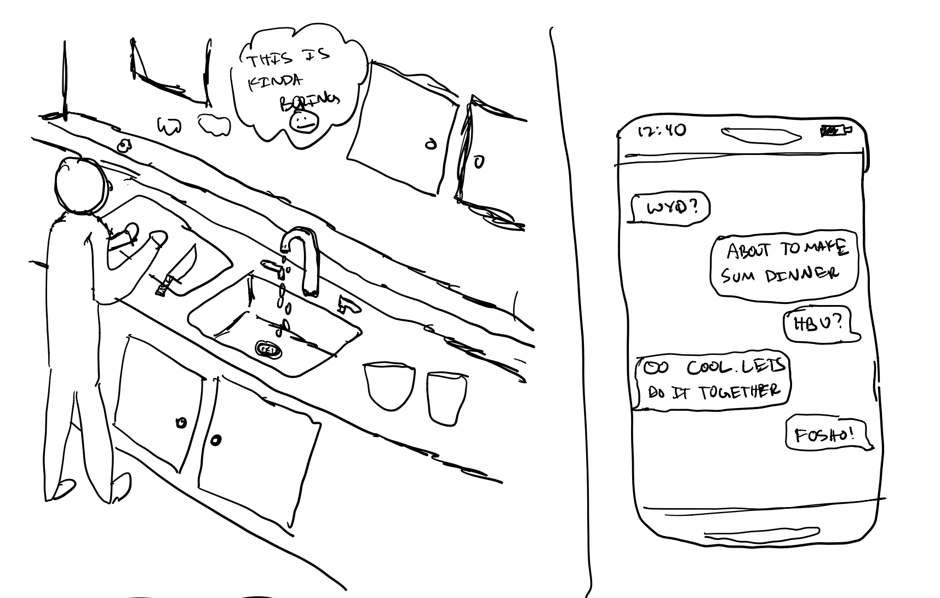
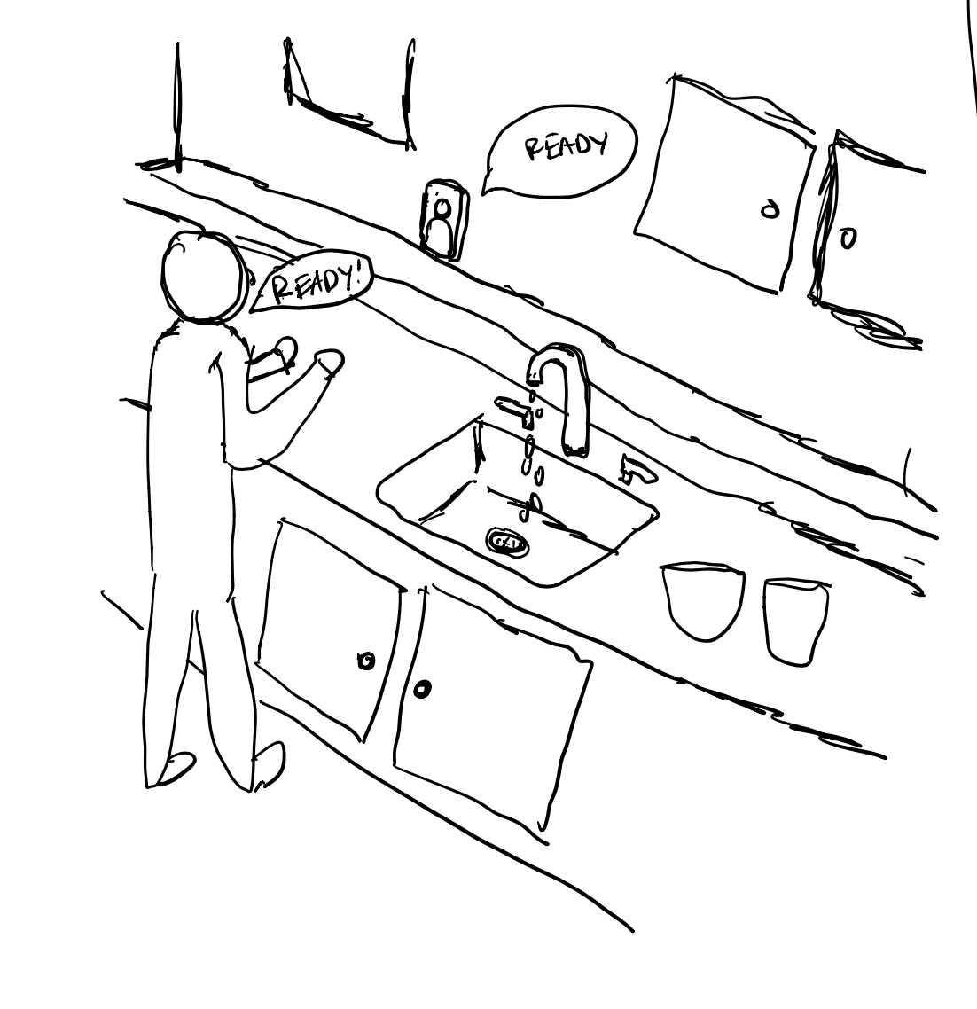
Storyboards: Scene 3
Notes:
Begins cooking competition and having fun with friend!

Slide 7
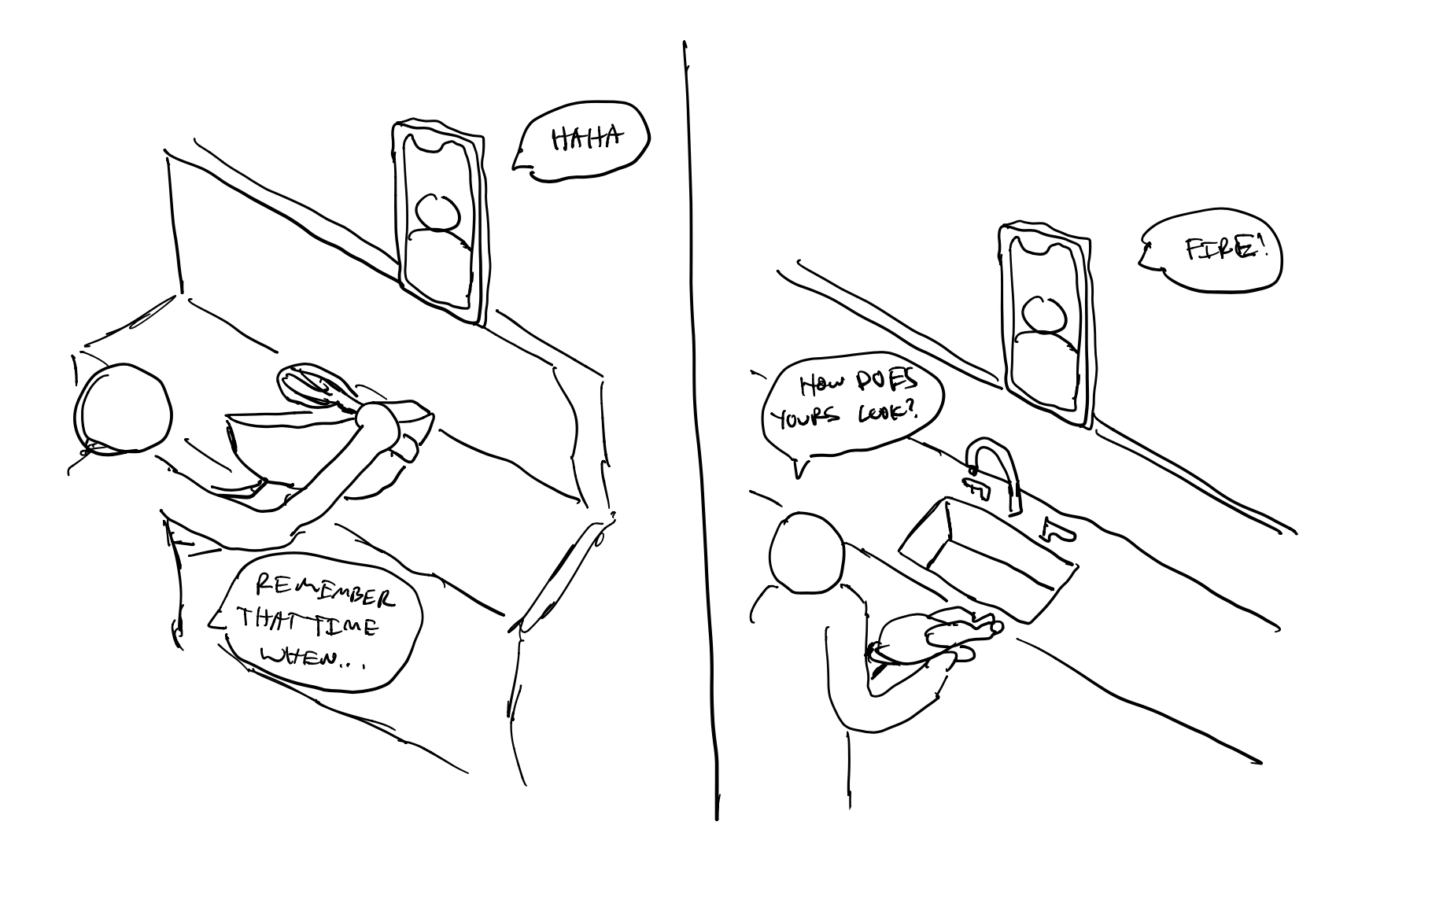
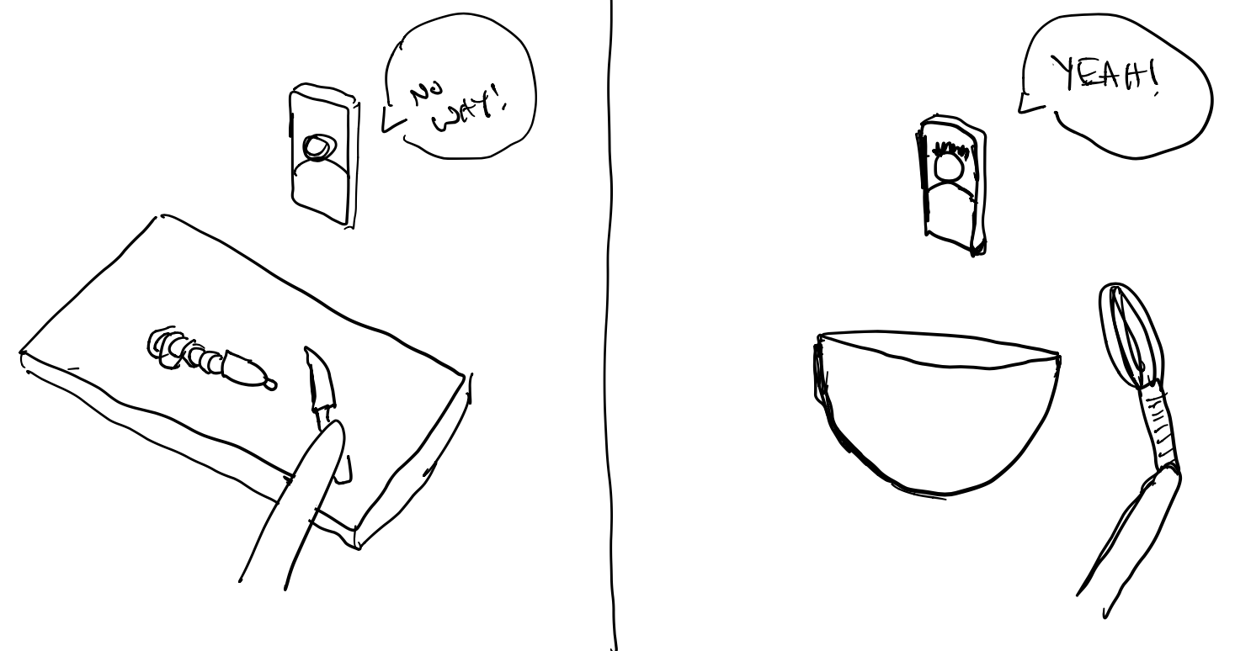
Storyboards: Scene 3
Notes:
Posts about the food!

Slide 8

Concept Video
Notes:
https://drive.google.com/drive/u/0/folders/1DYkW1SACxrMovXoyjANWNQG6CGyF3aO8
https://www.youtube.com/watch?v=Pe5TehEFuts

